Slide 1
Name
Title
Microsoft Corporation

Slide 2
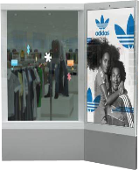
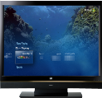
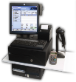
Windows For Specialized Devices
DEVICES
SERVICES & INFRASTRUCTURE
NATURAL USER INTERFACE
Speech Touch Sensory Analytics Graphics Handwriting
Notes:
Windows Embedded has a mission of extending Windows to the world of specialized devices
WEB solutions deliver connected experiences enabled by services across a range of devices including handheld terminals, Point-of-Service devices and digital signage in the enterprise to personal media players, digital photo frames and connected media devices in the consumer segment.
Windows Embedded is the family is the platform of software and services that bring the innovation and power of Windows to the huge world of connected, service-oriented devices.
The Windows Embedded Business is ideal for managing a business like Enterprise mobility terminals
High degree of leverage across Microsoft
Small but growing business
Leverage of direct and indirect channels in order to reach the broadest set of OEMs
Ability to manage a partner ecosystem

Slide 3
Introducing Windows Embedded Compact 7
Windows Embedded Compact 7 is the evolution of Windows Embedded CE
Microsoft’s platform for specialized, small footprint devices on ARM, embedded x86, and MIPS
OS platform and tools for device partners to build sustainable competitive differentiation based on speed to market, ecosystem and new technologies
Logical migration solution for customers on CE5 and CE6 planning their next device and supported by Windows Embedded marketing efforts industrial automation, retail and medical

Slide 4
Compact 7 business value for OEMs
Performance with new processors, SMP and hard real-time
Reliability with seamless device wired and wireless connectivity
Flexibility to power range of specialized devices
Speed to market with complete, integrated developer tools
Support from Microsoft and large ecosystem of partners
Device differentiation with new UI technology

Slide 5
Compact 7 product highlights
Adds support for ARM v7
New BSPs from TI, Freescale, Samsung and others
Powerful new features to help bring specialized devices to market faster
New developer and designer tools
Silverlight for Windows Embedded for creating user interfaces
New SMP support for x86 & ARM, MIPS
New multimedia player, with customizable UI
New Internet Explorer with Flash 10.1
Updated Office Viewers
Improved Connectivity to PCs, servers
Notes:
Note on toolkit:
Lots of new functionality, same price as CE6 toolkit!
Toolkit replacement program
Effective December 1st, 2010 until launch
For each eligible CE6R3 toolkit purchased, Embedded Distributor will receive one (1) unit of Windows Embedded Compact 7 toolkit as royalty-free replacement

Slide 6
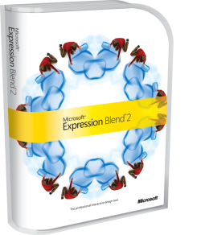
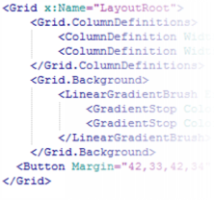
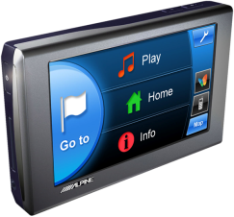
Silverlight for Windows Embedded
Expression Blend
Silverlight for Windows Embedded allows OEMs to create attractive, intuitive device and application UIs more quickly than conventional methods
XAML
Device differentiation and UI modifications can be quickly prototyped and implemented with impacting application logic developers
Web App
Device UX
Desktop App

Slide 7
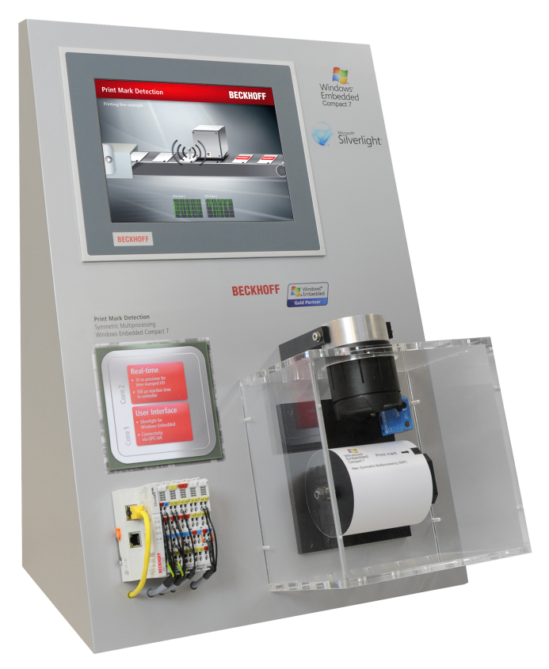
Silverlight for Windows Embedded UI framework
Develop attractive, intuitive UIs faster using Silverlight for Windows Embedded
Flexibility to modify UI throughout development
Native C++ application model
H/W acceleration
Based on Silverlight 3.0
Sample XAML UIs included

Slide 8
Business value
Case study examples of CE in action…

Slide 9
Wind Power Turbine Automation and Monitoring
AREVA Multibrid GmbH is a manufacturer specializing in the production of massive offshore wind turbines
In conjunction with partner Beckhoff Automation, AREVA developed a next-generation turbine with high reliability and connections to onshore monitoring and control systems
Key Benefits
Highly reliable platform with hard real-time performance
Integration with Windows-based enterprise systems
Long-term product and support commitments
Notes:
The Multibrid M5000 is the first turbine designed exclusively for large-scale offshore wind farm
An embedded controller, running Windows Embedded CE has transformed the turbine into a fully automated, self-monitoring energy plant capable of powering 50,000 German households
“Windows Embedded CE met all of our requirements perfectly. It is a small, stable, and scalable real-time OS that is also open to adding PC-like functionality like FTP file transfer and a graphical user interface. Windows Embedded CE delivers hard real-time performance in a componentized form combined with all of the familiarity and power of Windows technology.”
Bernd Zickert, Team Leader, Electrical Engineering, AREVA Multibrid
To see the case study, visit:
http://www.microsoft.com/casestudies/Microsoft-.NET/AREVA-Multibrid-GmBH/Real-Time-Embedded-Controller-Makes-Offshore-Wind-Power-Reliable/4000005427

Slide 10
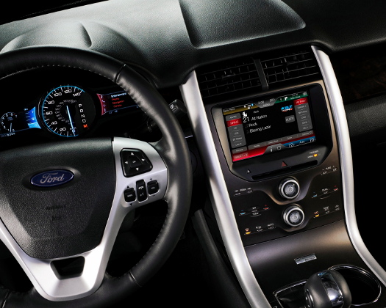
Compact 7: The Engine of Windows Embedded Automotive
Windows Embedded Automotive is based on Windows Embedded Compact 7
This industry-leading embedded platform is shipped in millions of cars every year
Automakers benefit from both the large Ecosystem of embedded developers as well as the opportunity to take advantage of key new Compact 7 features, like
Multi core processor support
New internet browser
And hundreds of software components

Slide 11
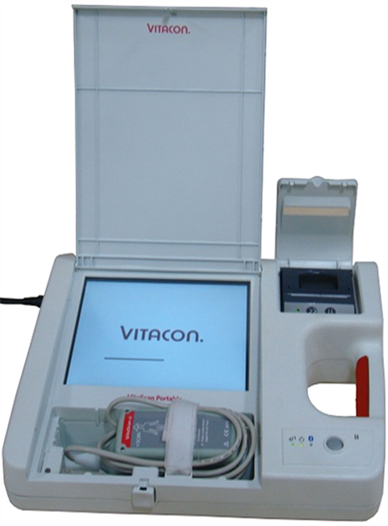
Medical Device Support – Rapid Development and Deployment
Vitacon develops, manufactures, and distributes products worldwide to treat incontinence, and diagnose bladder dysfunction
Microsoft Windows Embedded CE 6.0 R2 was chosen for the device’s operating system, because of key features like
Platform reliability
Integrated Bluetooth connectivity
Developer toolkit
Ease of use
Multilingual support
Notes:
By leveraging Microsoft’s powerful development tools and technologies, L&T reduced development time by approximately 100 days to make the deadline.
We estimate that the VitaScan Portable increases a hospital worker’s efficiency by 50 percent compared to manual paper-based processes.
Svein Wognild, Chairman, Vitacon
To see the case study, visit:
http://www.microsoft.com/casestudies/Case_Study_Detail.aspx?CaseStudyID=4000008701

Slide 12
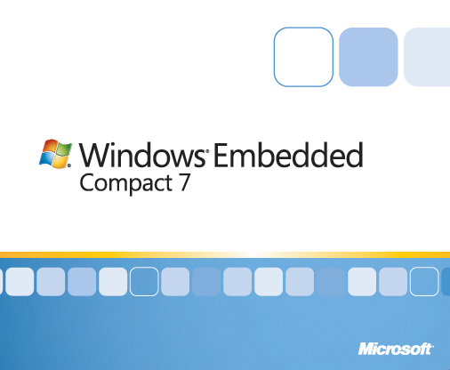
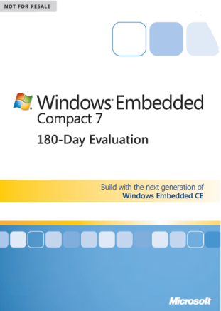
Compact 7 toolkits
Full Product
Available 1 March 2011
Evaluation
Available / Download 1 March 2011
Windows Embedded Compact 7 with Platform Builder and Compact Test Kit
Visual Studio 2008, Professional Edition
Expression Blend 3
180-day Windows Embedded Compact 7 with Platform builder and Compact Test Kit
90-day Visual Studio 2008, Profession Edition
30-day Expression Blend available for download
NB: All evaluation versions are downloadable. Compact 7 and Visual Studio DVDs included with physical evaluation DVDs

Slide 13
Compact 7 SKUs
SKU Name
Market
Key Features
C7P
Unrestricted
All Components: Browser, Flash 10.1, DLNA, WDS, MTP, Media Player, RDP, ActiveSync, MAPI Office Viewers, SLWE, Touch
C7G
Consumer Devices
DLNA, Streaming Media, MTP, Browser, Flash 10.1
Office Viewers, WDS, SLWE, Touch
C7E
Embedded
SLWE, WDS, WSD, Touch
C7NR
Personal Navigation Devices
Touch, Bluetooth, Connection Manager, Wi-Fi, Cellular/Mobile Data

Slide 14
Compact 7 Features
Symmetric Multiprocessing
DLNA
New Internet Explorer with Flash 10.1
Silverlight for Windows Embedded
Tools Improvements

Slide 15
Symmetric Multiprocessing Support
Kernel supports up to 250 cores
Practical limit is 8 cores
Takes advantage of new multicore embedded CPUs
x86, ARM, MIPS
No single thread lockup scenarios
Much more stable systems
CPU core management API provided
Notes:
Updated Memory Manager
Physical memory supported to 3 GB
Was 512 MB on Embedded CE 6
Rewritten Application Heap Manager
Reduces fragmentation in applications
Improves application stability
Kernel Security Updates
Address Space Randomization (ASR)
Randomizes load address of DLLs
Increases security by making addresses nondeterministic
Data Execution Prevention (DEP)
Prevents code from executing out of data pages
File System Updates
Significant work on performance
Throughput improved through code path analysis and improvements
USB and SD storage much faster
Secure Digital (SD) driver rewrite for performance
USB Host controller driver much better
Low Storage notifications
Notifies system when volume nearing full
Drive Updates
USB Host Controller Improvements
Better throughput
Driver tested internally for USB compliance on a specific platform
Better tests in CTK
New I2C driver
Provides common solution for ubiquitous bus
Accelerometer
Provides common interface for accelerometer
Bluetooth 2.1 +EDR
Broad Support Packages
Fewer changes than from 5.0 to 6.0
Short porting time
3-5 days instead of 6-7
Extensions for SMP/More physical RAM
Optional
Project porting a bit more challenging
A number of updates to SYSGEN variables
Security
Module-based security continues
Still Go/Nogo module load decision
ACL-based security is unsupported
Updated support for loader security
LVMod replaces Certmod
Kerberos
Updated to 5.0, equal to Desktop
NT LAN Manager v2
Upgrade
Other new features
Composition engine
Better Gesture support
Multitouch
XML lite
Consistent with desktop implementation
RPC update
Latest libraries

Slide 16
Digital Living Network Alliance
Group of Personal Computer, consumer electronics and mobile companies to enable products work together across a home network
Common Tasks
Find movie (locally or on the home network) and play it
Photo slide show on TV
Play or download music
Upload photos to home PC / NAS / PC server
Print photos
Common Device Types
TVs, PCs, Smartphones, Printers, Set Top Boxes, Stereos…

Slide 17
Internet Explorer for Embedded
New Internet Explorer
Based on IE 7
Some performance updates from IE 8 added
Flash 10.1 renderer shipped with OS
Full gesture support
Pinch to zoom
Swipe to pan
Extensive performance work on page display
Quicker rendering
Quick gesture response

Slide 18
Silverlight for Windows Embedded
Joins the best of both worlds
Rich user interface defined in XAML
Speed and power of native C++ code
Silverlight rendering engine enables custom user interfaces free from standard Windows chrome
Native code enables
Direct access to hardware
No garbage collect pause as in managed code
Silverlight enables the Designer / Developer paradigm
Designers develop the U/I independently of the business logic
Developers develop the business logic independently of the U/I
Windows Embedded Silverlight Tool bridged Expression Blend with Platform Builder
Notes:
Windows Embedded Silverlight Tool (WEST)
Tool to bridge Expression Blend with Platform Builder
Takes Blend project and generates C++ project
Multiple passes supported
Designer can work in parallel with developer
Supports
XAML controls
Placeholders for Win32 controls
SWE Improvements from CE 6 R3
Upgrade from Silverlight 2 to Silverlight 3 support
Better performance
Expression Blend 3
Perspective transform
Pixel Shaders
Bitmap Caching
Writable bitmap

Slide 19
Silverlight Comparison
Silverlight
Silverlight for Windows Embedded
Apps run in sandbox
Rich U/I generated in Expression Blend
Code written in C#
Managed BCL
Apps run native on box
Rich U/I generated in Expression Blend
Code written in C++
Win32 API
Notes:
SWE Unsupported Features
Managed Code
Code behind is native C++
MediaElement object
Application can still embed at native media control
Data Binding
Must be manually added in native project
Behaviors
Control actions must be implemented in native code

Slide 20
New Tools Improvements
Platform Builder 7
Now an add-in to Visual Studio 2008
Kernel Debugger Features
Better breakpoints, Thread affinity, Improvements to support SMP.
Build Features
Checked builds, better build performance, Compiler updates
Remote Tools
Central PC-based IDE, Kernel tracker/Timeline viewer
Compact Test Kit
Dramatic rewrite, new PC-based Integrated test application
Notes:
Platform Builder 7 New features
Alternate Release Directories
Searches multiple release directories for modules
Loadable Error Lists
Load a build log from another machine and see errors
Automation Scripts
Easily extend build actions with scripts
New Kernel Debugger Features
Better Breakpoints
Conditional breakpoints
Data Breakpoints
Thread affinity
Improved reliability when stepping through multithreaded code
Improvements to support SMP
Build Features
Checked Builds
Optimized like retail builds but includes debug checks
Smaller builds
Debug checking included
Better build performance
Build times reduced for both build clean and rebuild
Compiler Updates
New Remote Tools
Tools now incorporated into Remote Tools Framework
Central PC-based IDE
Kernel Tracker / Timeline Viewer
Dramatically improved over original Kernel Tracker
New Features
Zoom selected area
Switch between table and graph view
Analysis of logged data
Scanner window to provide global perspective
Compact Test Kit (CTK)
Dramatic Rewrite
Formerly known as the CE Test Kit (CETK)
New PC-based Integrated test application
Now uses CoreCon for communication
Caution
Old tests must be recompiled

Slide 21
Summary
Windows Embedded Compact 7 is the evolution of Windows Embedded CE
For specialized, small footprint devices on ARM, embedded x86, and MIPS
Logical migration for CE5 & CE6 customers planning next device
Flexible platform supporting a wide range of specialized devices
New UI technology speed development and differentiate devices
Delivers performance via new processors, SMP and hard real-time
Complete developer toolkit and test kit means less configuration and faster development

Slide 22
Download 180-day evaluation today www.windowsembedded.com/compact

Slide 24
Category | Feature | C7NR | C7E | C7G | C7K | C7P
Rich User Experience | Software Input Panel (SIP) and subcomponents | - | ✔ | ✔ | - | ✔
 | Silverlight for Windows Embedded | - | ✔ | ✔ | ✔ | ✔
High Fidelity Internet | Internet Explorer 7.0 and subcomponents | - | - | ✔ | - | ✔
 | Flash Player 10.1 | - | - | ✔ | - | ✔
Ease of Connectivity | Remote Desktop Protocol (RDP) and subcomponents | - | - | - | ✔ | ✔
 | Windows Network Projector and subcomponents | - | - | - | ✔ | ✔
 | Terminal Emulator | - | - | - | - | ✔
 | ActiveSync AirSync | - | - | - | - | ✔
 | ActiveSync Inbox Sync | - | - | - | - | ✔
 | Pocket Outlook Database Sync | - | - | - | - | ✔
 | CE Messaging API (MAPI) | - | - | - | - | ✔
 | Pocket Outlook Object Model | - | - | - | - | ✔
 | SMS Transport for CE MAPI | - | - | - | - | ✔
 | Windows Media Player | - | - | ✔ | - | ✔
 | Media Library | - | ✔ | ✔ | - | ✔
 | Media Content | - | - | ✔ | - | ✔
 | Media Sync for Windows Device Stage including Media Transfer Protocol (MTP) Responder and subcomponents | - | ✔ | ✔ | ✔ | ✔
 | WMA and MP3 Local Playback | - | - | ✔ | - | ✔
 | WMA and MP3 Streaming Playback | - | - | ✔ | - | ✔
 | Streaming Media Playback | - | - | ✔ | - | ✔
 | Cellcore Voice | - | - | - | - | ✔
 | Link Layer Topology Discovery Responder | - | - | ✔ | ✔ | ✔
 | Universal Plug and Play (UPnP) and subcomponents | - | - | ✔ | ✔ | ✔
 | Web Services On Devices | - | ✔ | ✔ | ✔ | ✔
Other | Office Viewers and subcomponents | - | - | ✔ | ✔ | ✔
 | PDF Reader | - | - | ✔ | ✔ | ✔
 | WordPad | - | - | ✔ | - | ✔
 | SQL Compact and subcomponents | - | ✔ | ✔ | ✔ | ✔
 | Help | - | - | ✔ | - | ✔
 | C Libraries: Open MP Runtime | - | - | ✔ | ✔ | ✔
 | AYG Shell API | - | - | ✔ | - | ✔
 | Graphical Shell | - | ✔ | ✔ | ✔ | ✔
 | Windows Thin Client Shell | - | - | - | - | ✔
 | Screen Configuration | - | ✔ | ✔ | ✔ | ✔
 | Control Panel, Silverlight for Windows Embedded | - | ✔ | ✔ | ✔ | ✔

